Slide 1

A DATA DRIVEN ANALYSIS AND OPTIMIZATION
APPROACH FOR ENHANCING ORGANIZATIONS
PERFORMANCE
PREDICTING EMPLOYEE PRODUCTIVITY:
SHIVANGI GUPTA
ASSISTANT PROFESSOR
PG DIPLOMA IN DATA SCIENCE
AASHIMA BANGIA

Slide 2


CONTENT
Introduction
Defining the question
Collecting the dataset
EDA
Model selection
Prediction

Slide 3

INTRODUCTION
The Employee Productivity Analysis project recognizes the significance of understanding and improving employee productivity within an organization. By conducting an in-depth analysis of productivity factors, organizations can identify areas of improvement, optimize resource allocation, and create strategies to enhance overall performance.

Slide 4

DEFINING THE PROBLEM
The primary objective of this research is to gain a comprehensive understanding of the current productivity levels within the organization. This involves analysing employee data, performance metrics, and other relevant information to establish a baseline for productivity.

Slide 5

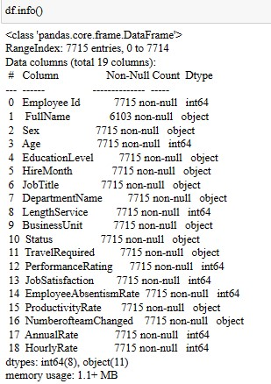
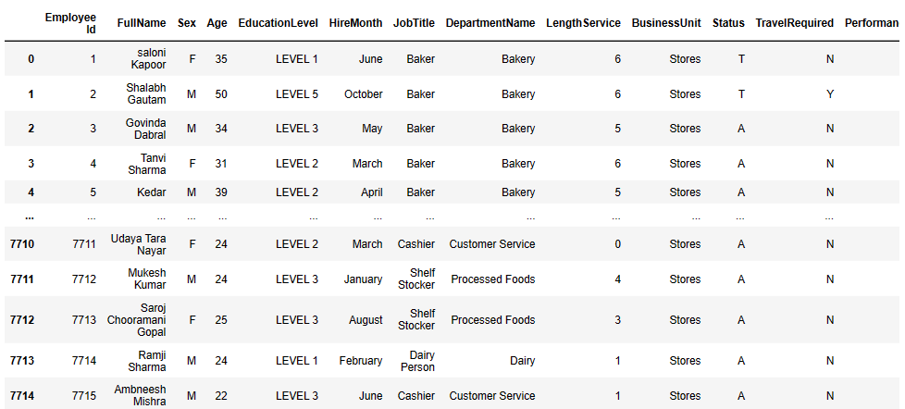

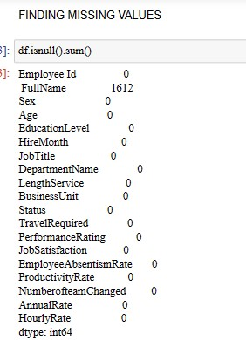
COLLECTING THE DATA
Following Data is collected from the company named “LALA JAI KISHAN ANIL GUPTA” Firm name “KULFI WORLD” owned by Mr. Aman Gupta.
It contains the 7715 records with 19 attributes.

Slide 6

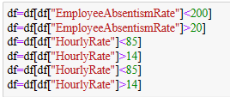
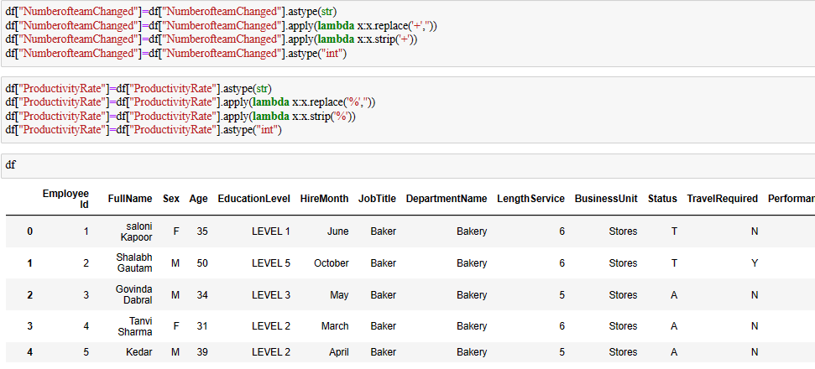
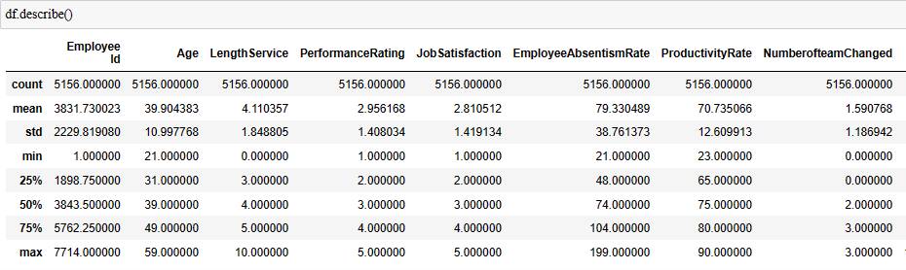
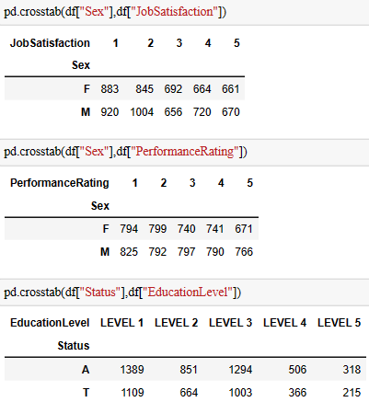
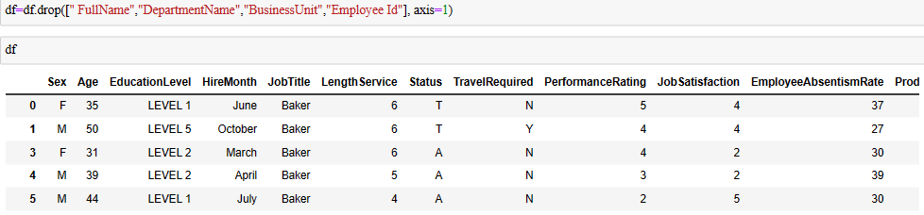

Slide 7

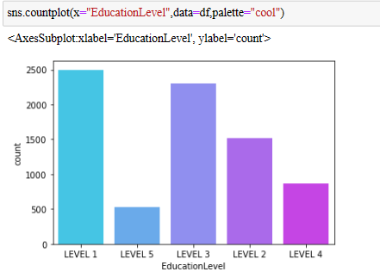
EXPLORATORY DATA ANALYSIS

Slide 8

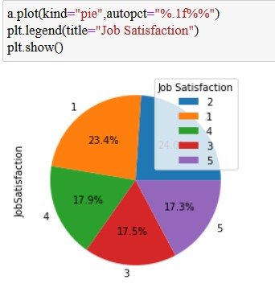
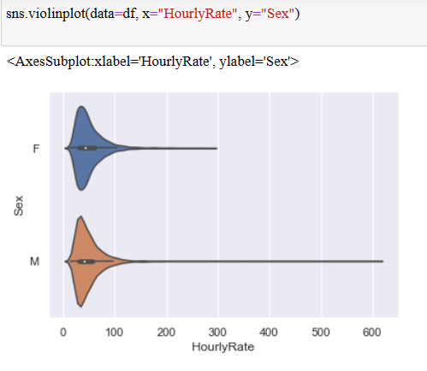
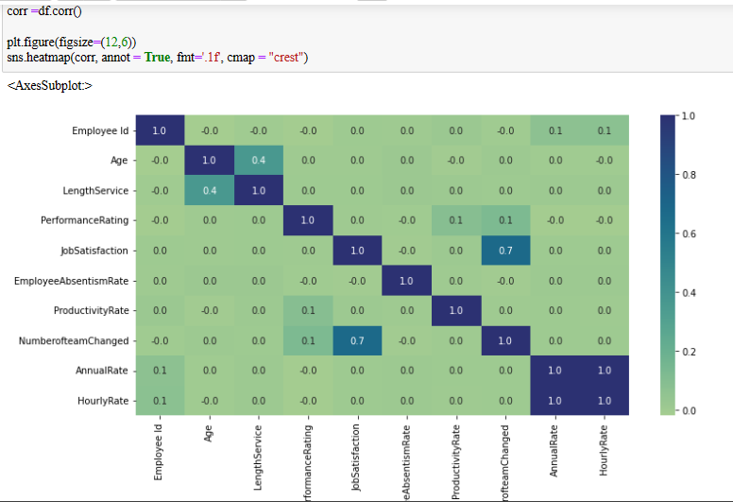
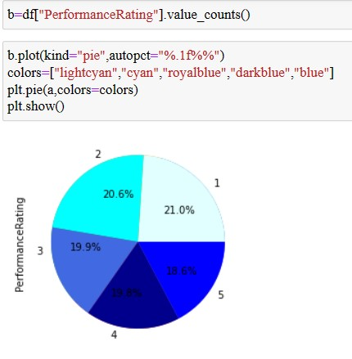
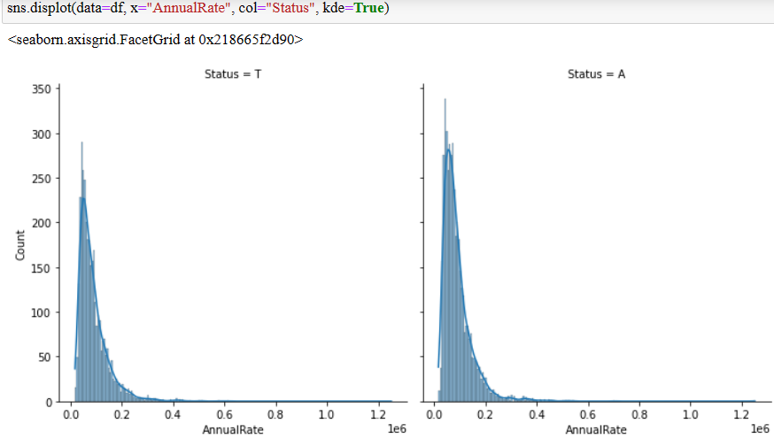
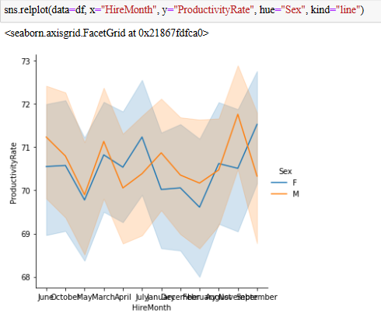
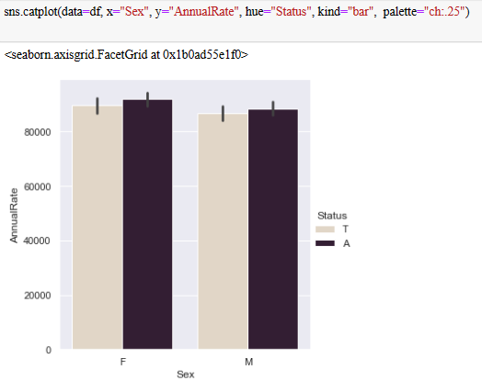

Slide 9

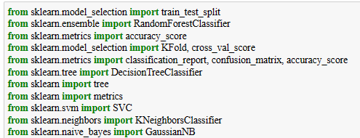
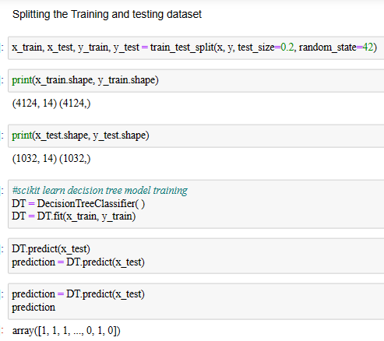
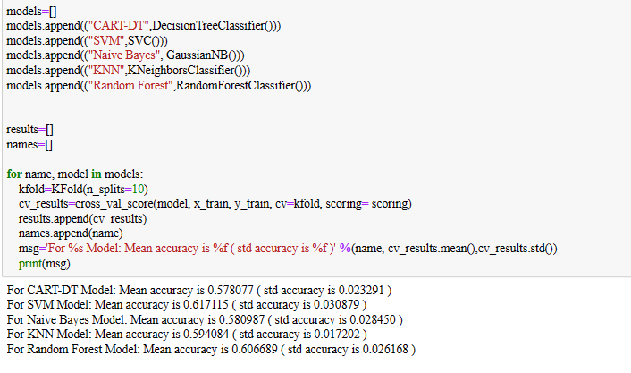
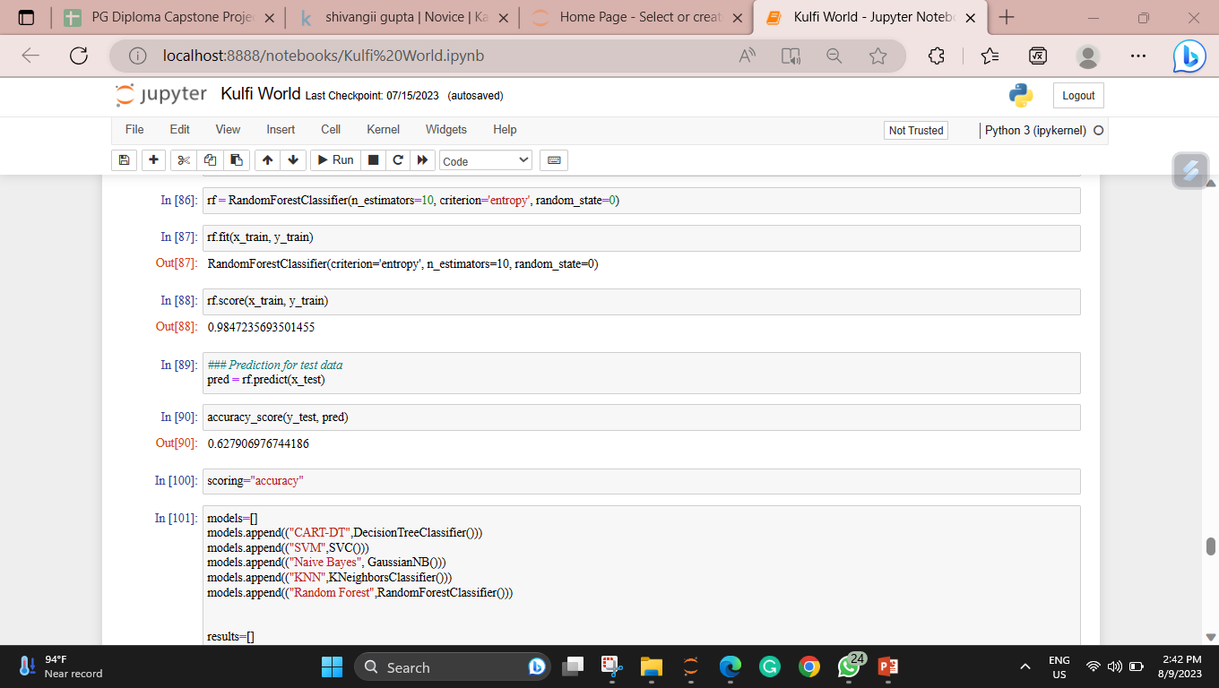
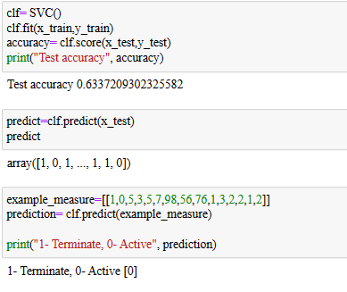
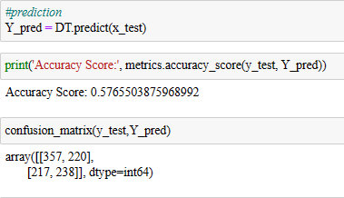
MODEL SELECTION

Slide 10
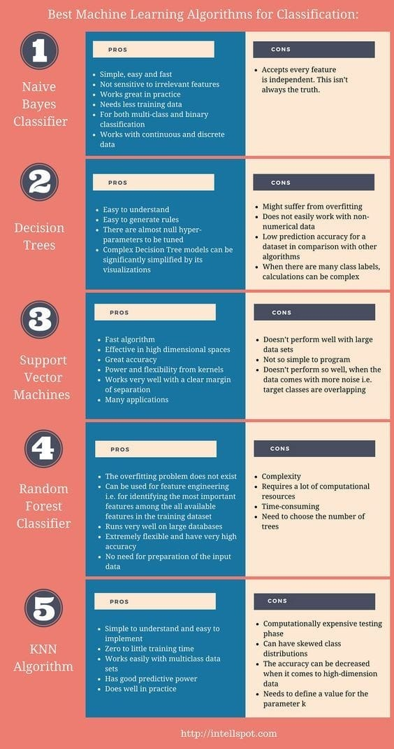

MACHINE LEARNING
MODELS

Slide 11

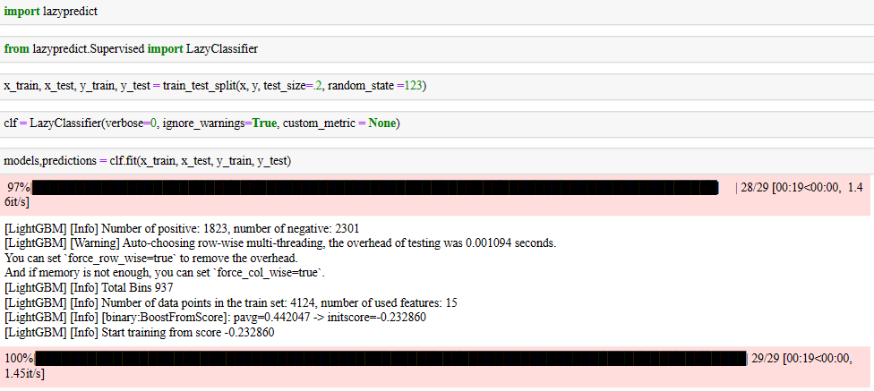
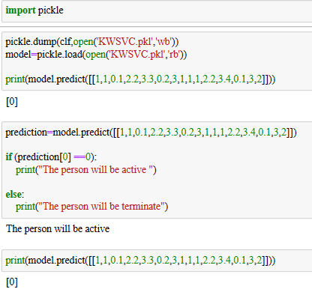
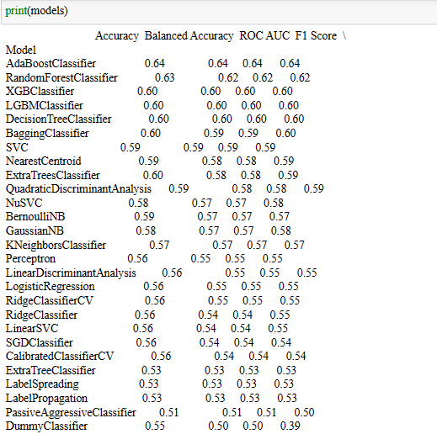
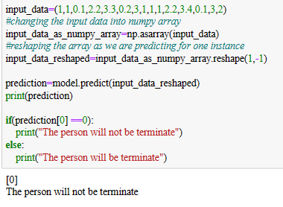
PREDICTION

Slide 12

THANKYOU

